Slide 1
Notes:
Logo slide.

Slide 2


A Guiding Map for DevOps
Matt Saunders Head of DevOps, Adaptavist
Notes:
Title card.

Slide 3
Doing DevOps Well
Measuring DevOps Success
Finding the Value
Mapping the Streams
Putting it all together
Notes:
Agenda slide. Include an agenda in every deck.

Slide 4
Doing DevOps Well
Measuring DevOps Success
Finding the Value
Mapping the Streams
Putting it all together
Notes:
Agenda slide. Include an agenda in every deck.

Slide 5




Doing DevOps Well
Good SCM & CI
Source code kept under version control
Software built on each integration
Access to Environments Always deploy your branches
Do this to fresh and consistent environments
Get Changes flowing smoothly
Automate away the friction
Make deploying changes a low-risk activity
Notes:
Three points stacked split with a white half.

Slide 6



Good SCM & CI
Keep everything in VCS
Never too soon for peer review
Tie this back to sprint planning
Build Continuously
Small incremental changes are easier to manage
Find and fix divergence early
Deploy at Will
Test and check your changes as soon as possible
Tighten those feedback loops
Notes:
Three points in a row. With some space added at the bottom.

Slide 7
Access to Environments
Allow Devs Access to Environments
Make them dedicated to their cause
Pre-built, or on-demand
Don’t Make them Queue
Waiting for environments harms flow
Focus on environment refresh
Production-like
It’s difficult but necessary to make environments ‘prod-like’
Look into data masking and representative data sizes for performance testing
Notes:
Three points in a row. With some space added at the bottom.

Slide 8
Change Flow
Make it easy to get through the Gates
Do you need that CAB?
Allay the Concerns
Good tests
Test real-world scenarios
Decouple
Reduce the dependencies of individual components
Make them independently deployable
Notes:
Three points in a row. With some space added at the bottom.

Slide 9
Doing DevOps Well
Measuring DevOps Success
Finding the Value
Mapping the Streams
Putting it all together
Notes:
Agenda slide. Include an agenda in every deck.

Slide 10
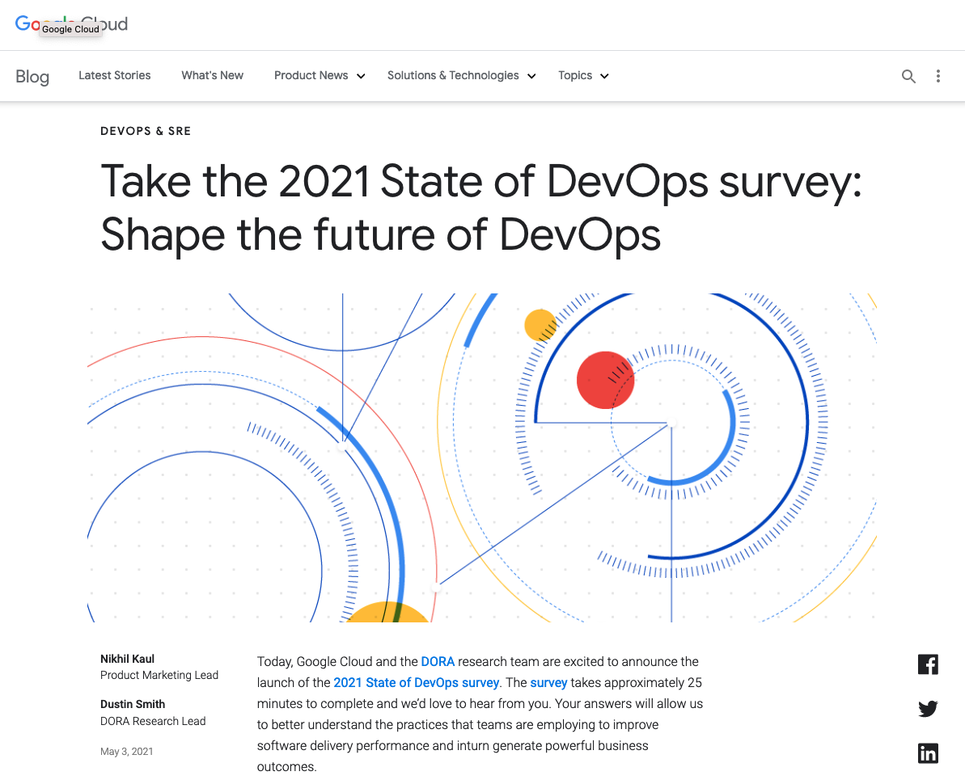
Measuring DevOps Success
DORA DevOps Research and Assessment
Well-Established Large correlation between these metrics and success
Evolution not Revolution Metrics and results have stabilised

Slide 11




Measuring DevOps Success
Deployment Frequency
Indicates mature deployment processes and willingness of the organisation to push change
Lead Time for Changes
Signals that teams are able to deploy changes without hold-ups or red tape
Change Failure Rate
Shows a high maturity in testing ability and teams are able to develop software safely
Time to Restore Service
An understanding of the organisation’s ability to swarm and solve problems, which will inevitably happen
Notes:
Four points.

Slide 12


Scaling Up
This works great in small teams … perhaps the two pizza teams championed by Jeff Bezos
But modern organisations are complex and we need to scale up
DevOps teams can form whether you want them or not
Platform teams help you make the most of your skills but can be a compromise

Slide 13

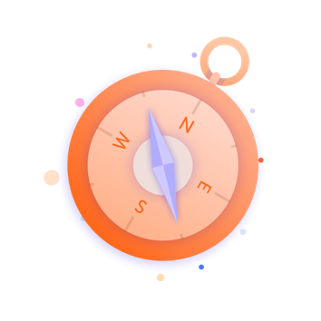

Old Problems Creep Back In
Silos
Isolated departments or teams fulfilling specific functions
Unseen Constraints Splitting work across teams can mask unseen constraints
Delays Often between these new silos
Don’t Repeat Yourself Attempts to share work and code can cause over-generalisations
Queues and Service Desks
Well-intentioned processes, streamlined to capture the correct data
Conflicting Objectives Teams are measured on aspects other than delivering quality software quickly
Notes:
Six points.

Slide 14


Reduced Flow
Increased Friction

Slide 15
Doing DevOps Well
Measuring DevOps Success
Finding the Value
Mapping the Streams
Putting it all together
Notes:
Agenda slide. Include an agenda in every deck.

Slide 16
Finding the Value
Focus on Flow
Scope is bigger than you think
Situational Awareness
Notes:
Three points in a row. With some space added at the bottom.

Slide 17
Doing DevOps Well
Measuring DevOps Success
Finding the Value
Mapping the Streams
Putting it all together
Notes:
Agenda slide. Include an agenda in every deck.

Slide 18
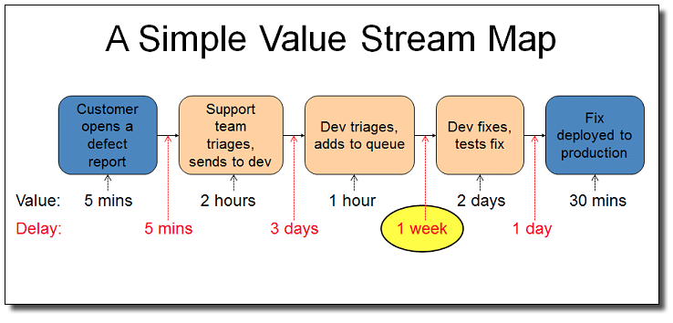
Make a Map
Source: IBM Garage Methodology

Slide 19
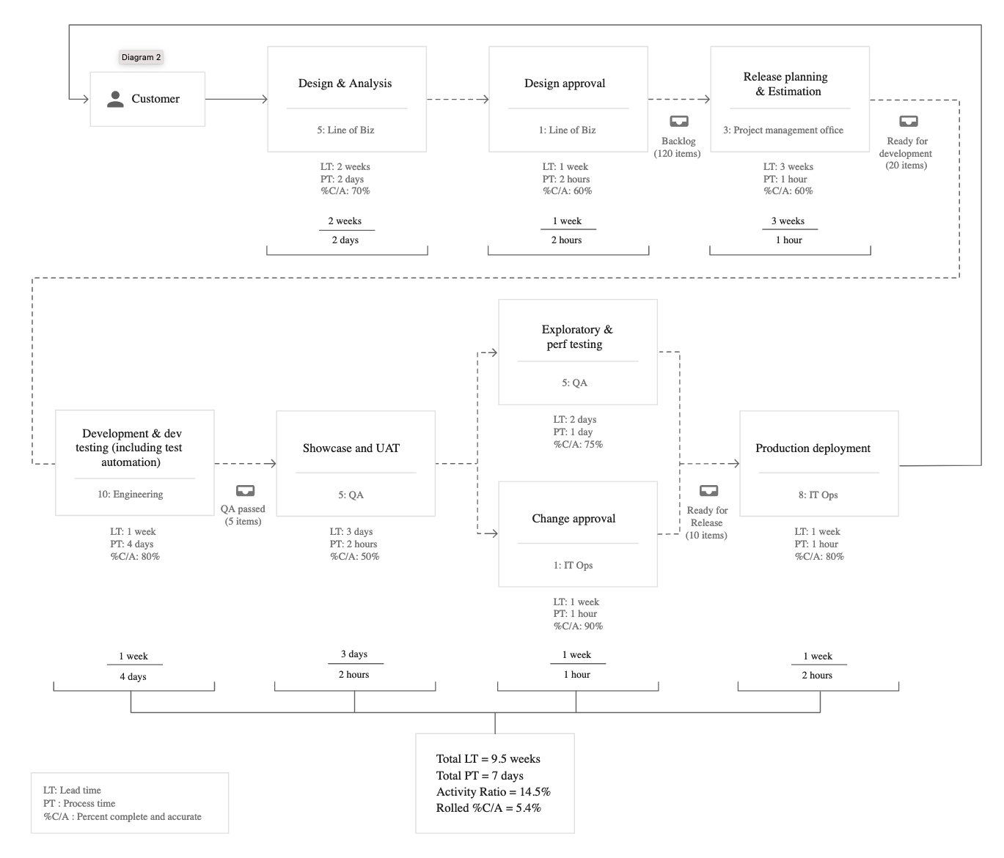
Make a Map
Source: Lean Enterprise

Slide 20

“20% improvement just from creating a value stream map”
Steve Pereira
Visible

Slide 21
Make a Wardley Map
A map for business strategy
Defining your context within the business is hugely important
Helps you with direction
‘Supplying’ DevOps to the rest of the company is a business unit in itself
What’s important?
You can figure out what is commoditised for you to use, and what you have to build instead
Notes:
Three points stacked split with a white half.

Slide 22
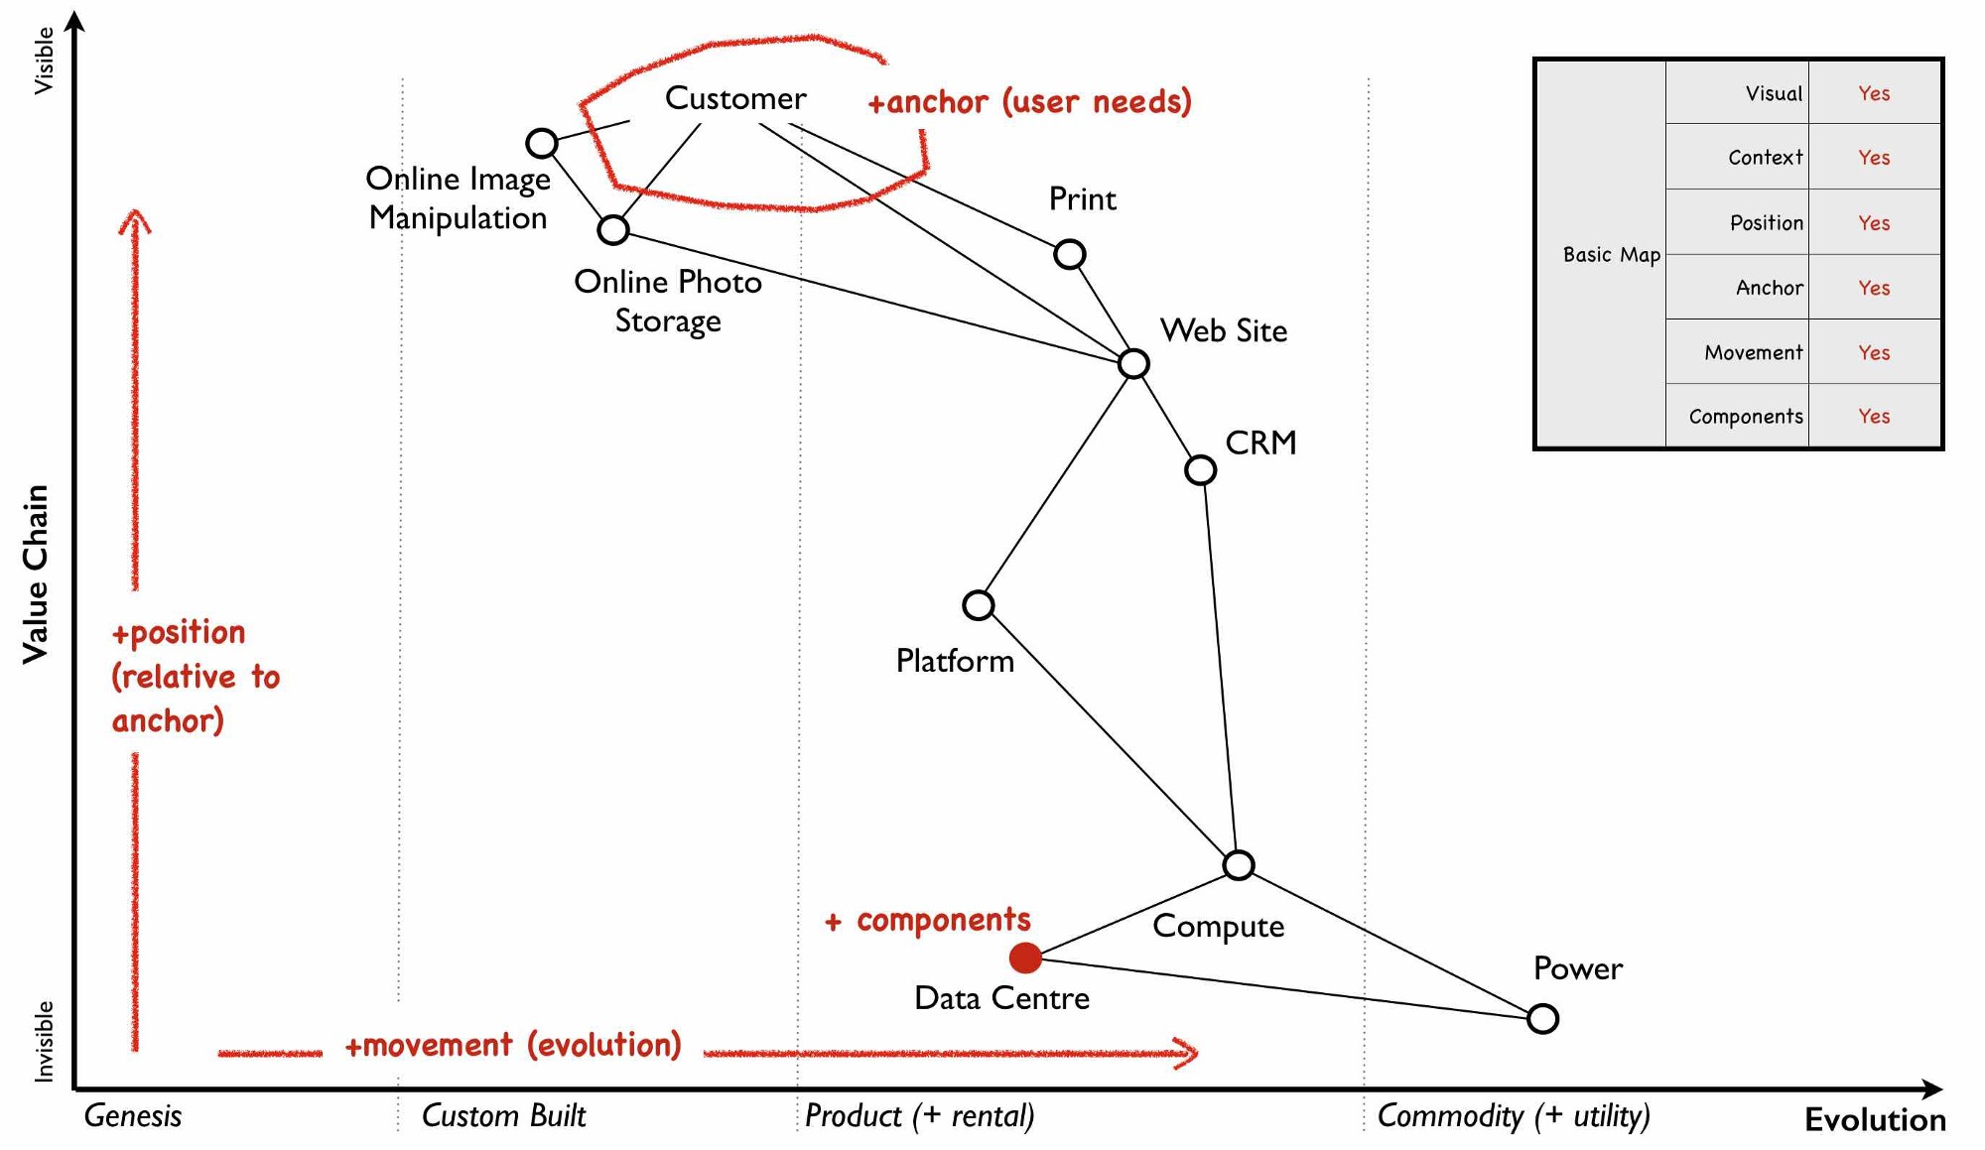
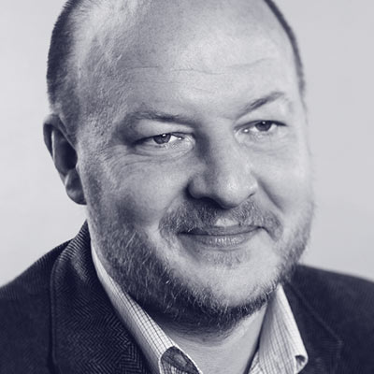
Make a Wardley Map
Source: learnwardleymapping.com

Slide 23
Map Results
Where can you add measurable value?
What can you ‘buy’ in?
What are you ‘building’ for others to consume?
Notes:
Three points in a row. With some space added at the bottom.

Slide 24
Doing DevOps Well
Measuring DevOps Success
Finding the Value
Mapping the Streams
Putting it all together
Notes:
Agenda slide. Include an agenda in every deck.

Slide 25
Takeaways
Help people to work together
They should all be in it to deliver the same thing - value
Focus on value Slim it down, don’t work on things that don’t add real value or that you can buy in
Understand where you are
Situational awareness is key
Use external touch points Talk more to your ‘customers’ - their needs will help set you straight
Map where you want to go
Works out where you are and what it will take to get where you want to be
Keep DevOpsing! Feedback loops, great automation, and making the best of your people
Notes:
Six points.

Slide 26

Adaptavist
adaptavist.com

Slide 27


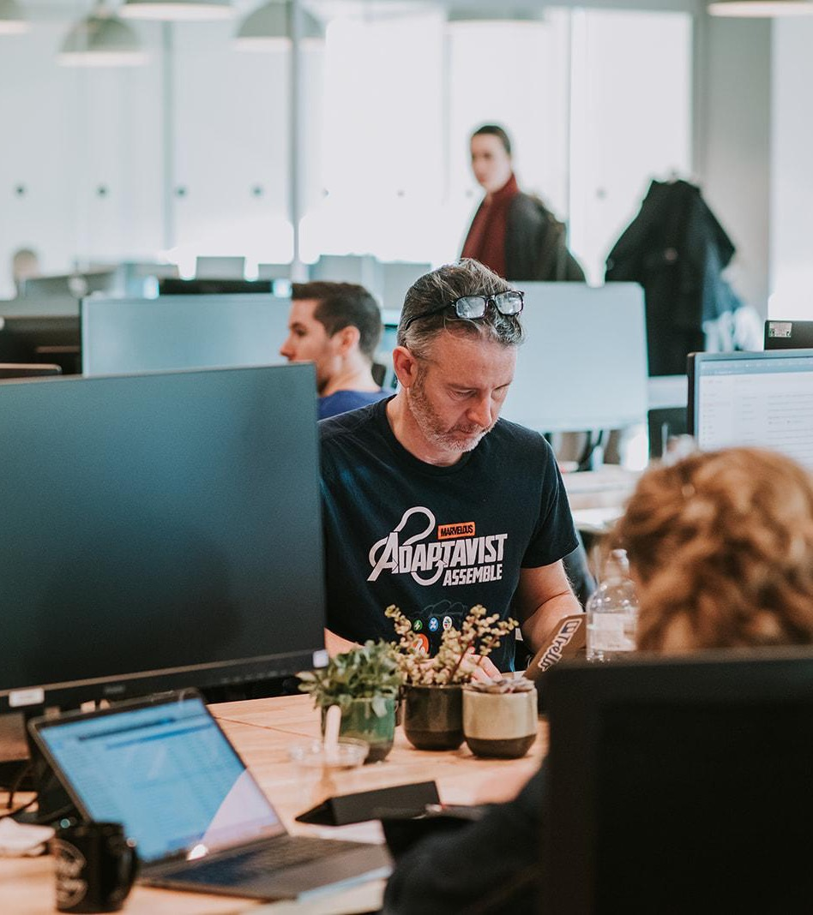
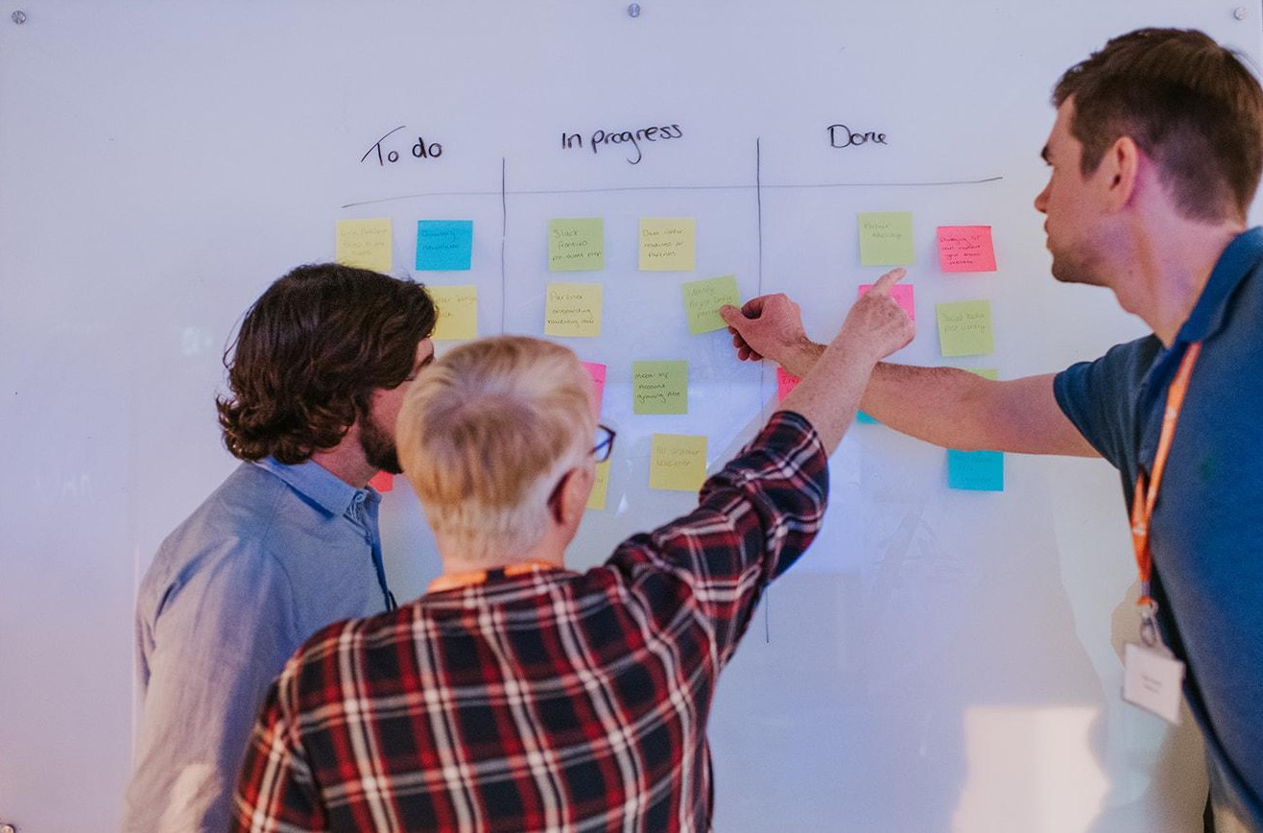

Adaptavist
adaptavist.com

Slide 28




Developing an Agile Organisation
What does it take to develop a truly agile organisation and why should you care as a leader?
Adapting to change: How developing the social network and patterns of conversation in your teams helps build organisational agility
Improving time to value: Looking at your normal, day-to-day work through a new lens to unlock more value from the things you are already doing
Unlocking collaboration: Practical examples of how to solve complex problems cross-functionally, putting collaboration at the heart of what you do
Notes:
Split ice and denim. With an example of a logo in the place of a title.

Slide 29
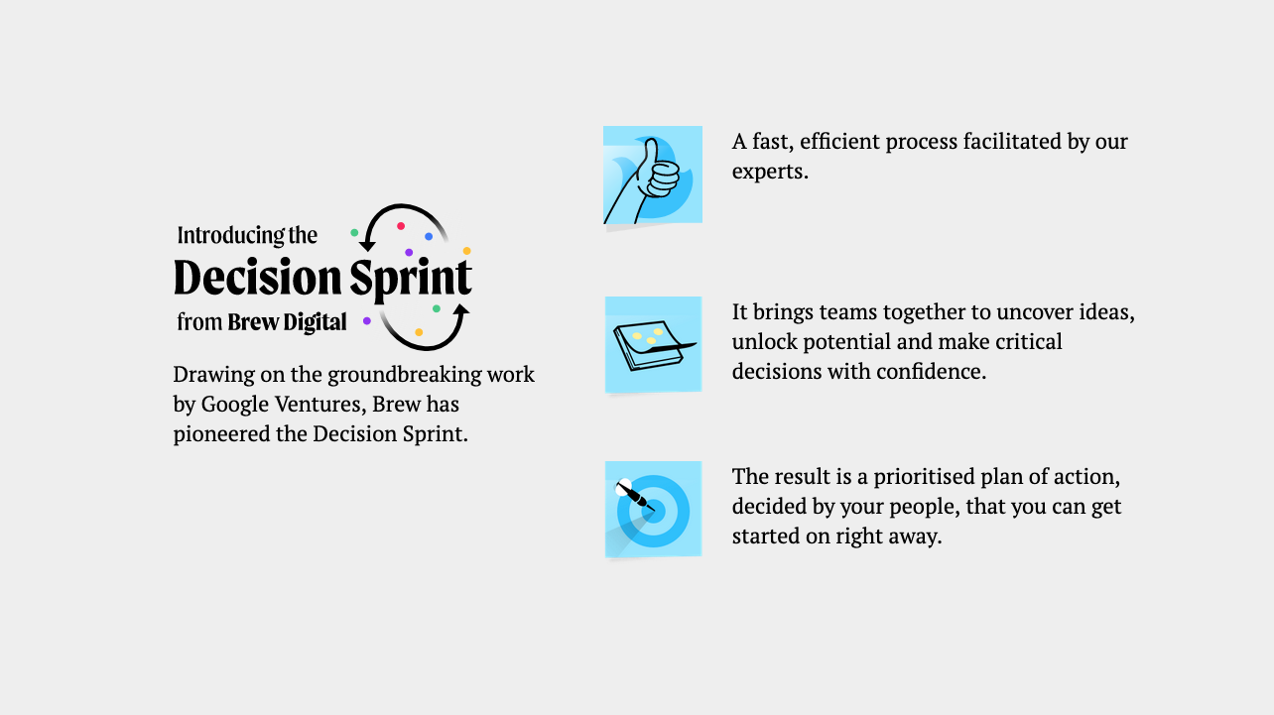
Decision Sprints
Notes:
Split ice and denim. With an example of a logo in the place of a title.

Slide 30
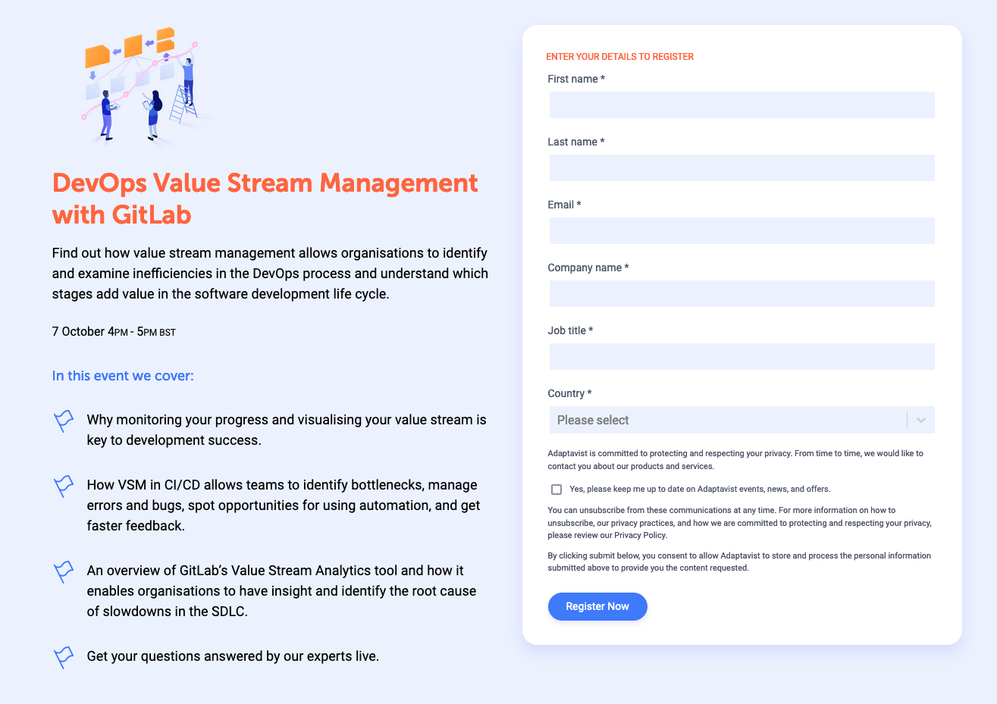
Notes:
Split ice and denim. With an example of a logo in the place of a title.

Slide 31
Thanks!

